Slide 1

Deploying Services Through AzureML
Nishant Velagapudi
W251

Slide 2
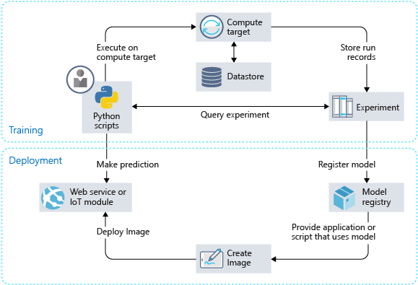
AzureML Capabilities

Slide 3
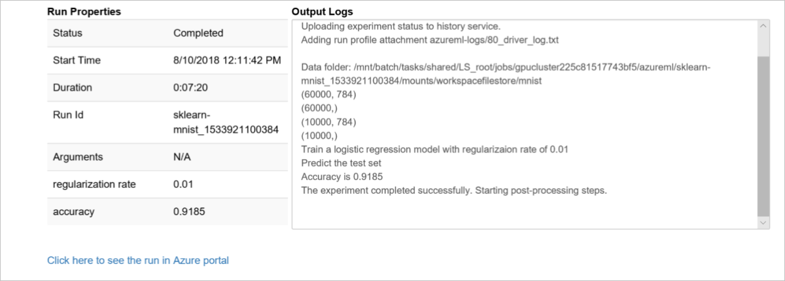
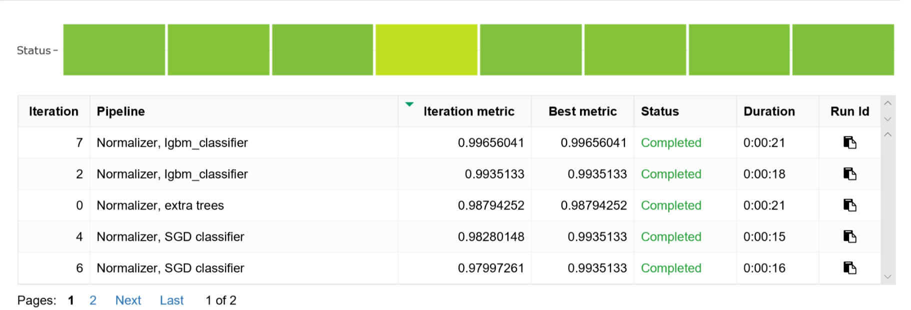
Train
Local train
Train on local box, upload model/dependencies
Train on remote cluster
Train on remote cluster
Register model on workspace
Auto hyperparameter tuning capabilities

Slide 4
Deploy
Automatically generate and deploy Docker image
Maintain history of images as convenient backup
Easy to troubleshoot – pull docker image and test locally
Variety of possible targets to deploy to
Local
Azure-hosted Linux VM
Azure Container Instance
Azure Kubernetes Service
Spec host machine as needed from list of azure SKUs

Slide 5
Management
Automate model retraining cycle
Programmatically replace model under registered name
Auto-scale number of agents
https://docs.microsoft.com/en-us/azure/machine-learning/desktop-workbench/how-to-scale-clusters

Slide 6
Personal Experience:
Multiclass classification – 200 outputs and growing
One-vs-All models yield best CV results
Each class adds ~10-12ms of prediction time

Slide 7
Scenario Constraints:
Conflicting requirements for speed and model performance
More model complexity can improve perf, but slows compute
Slower compute negative impacts KPIs

Slide 8
Approach
At call time, front-end web service does feature-preprocessing, asynchronously calls n internal services, reduces results
Exposed Web Service
Internal Service 1
Internal Service 2
Internal Service ..
Internal Service n
Algorithmically assign each class to one of n internal services
All Class One Vs All
Training Data
Retrain all classes with set cadence
Partner stakeholders provide and maintain training data

